Slide 1

NSG Pilkington – University of Liverpool Machine Learning Project: 11/11/2020
Dr. Peter Green
Diego Echeverria
Risk Institute,
School of Engineering

Slide 2
To-do (short-term)
Currently no time lags associated with campaign data.
Need bespoke filtering for some of the signals (we can do this with an extra column in the spreadsheet).
Some of the data outside of ‘eng min-max’ need to be processed and included in the data pipeline.
To-do (longer-term)
Establish and implement strategy for processing data that is affected by reversals.
Repeat analysis that use randomly selected inputs and/or randomly selected time lags.
Consider using a multi-output linear regression

Slide 3
To-do (short-term)
Currently no time lags associated with campaign data.
Need bespoke filtering for some of the signals (we can do this with an extra column in the spreadsheet).
Some of the data outside of ‘eng min-max’ need to be processed and included in the data pipeline.
To-do (longer-term)
Establish and implement strategy for processing data that is affected by reversals.
Repeat analysis that use randomly selected inputs and/or randomly selected time lags.
Consider using a multi-output linear regression

Slide 4
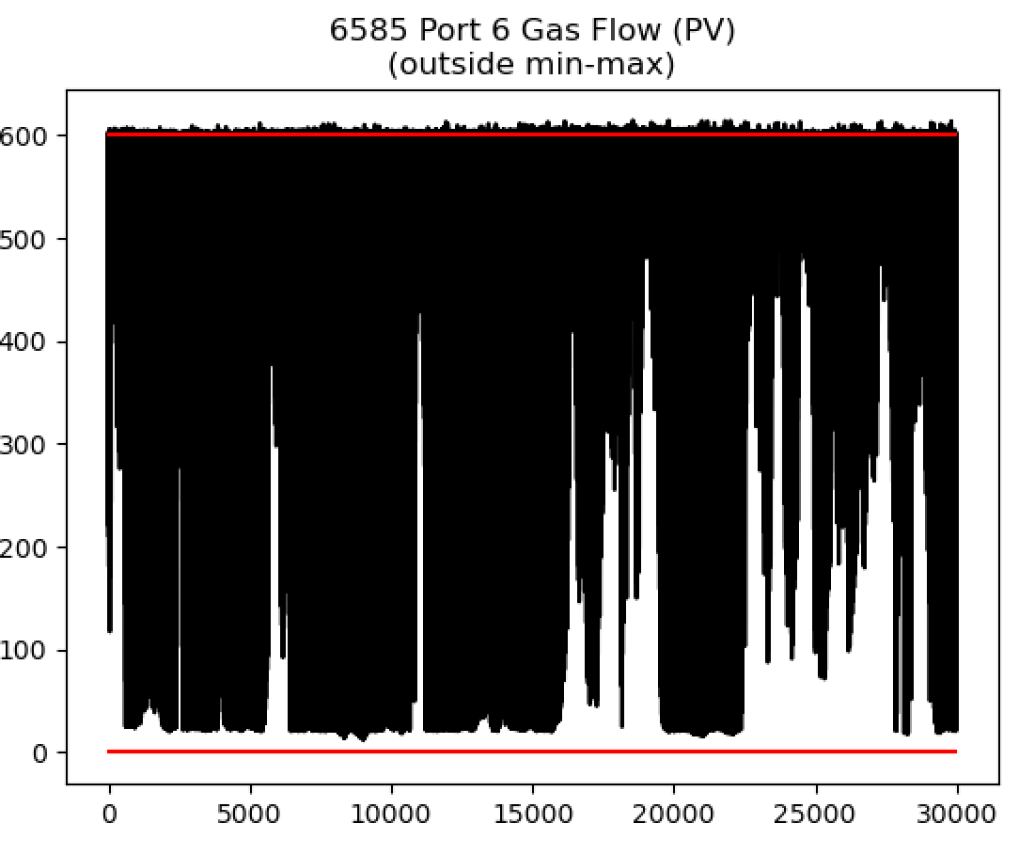
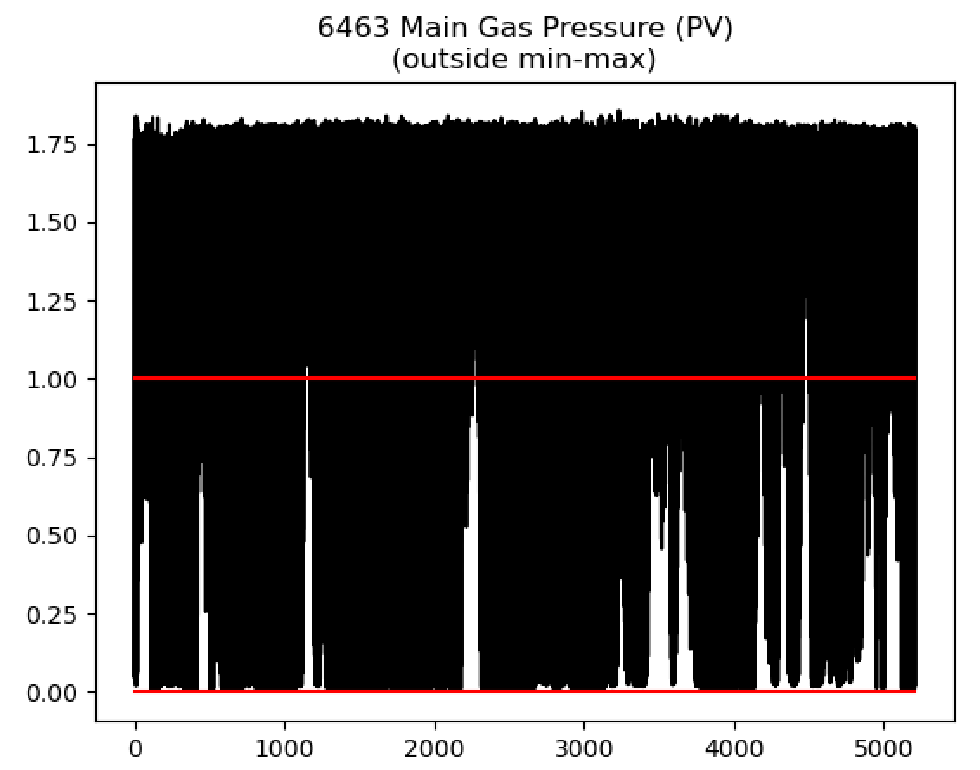

Slide 5
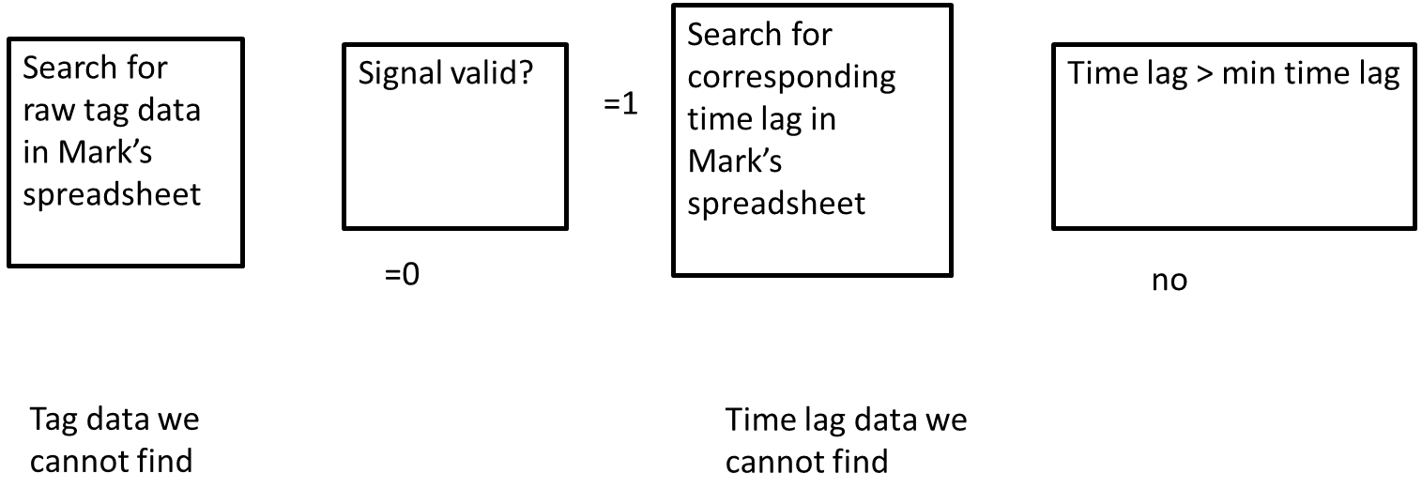
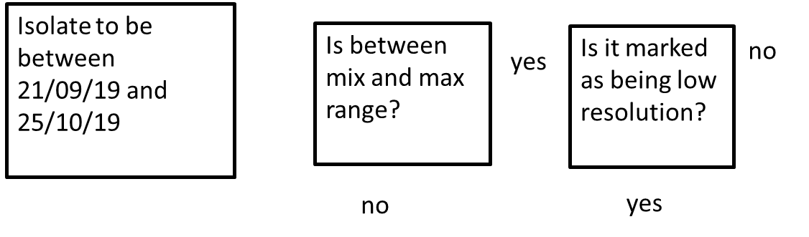
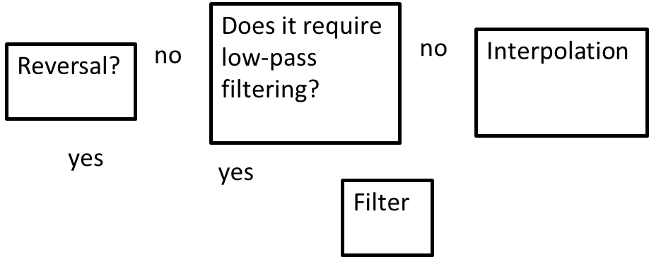
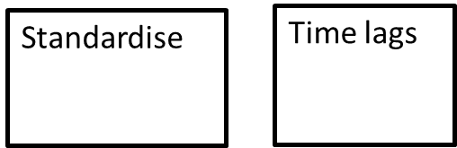
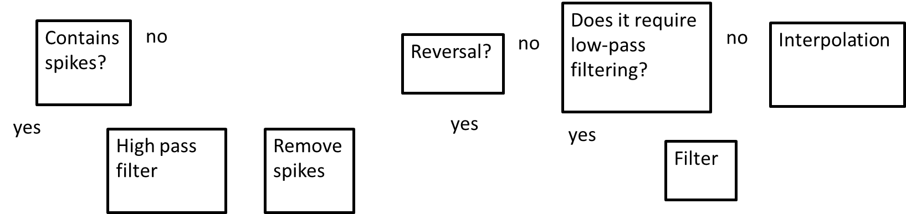
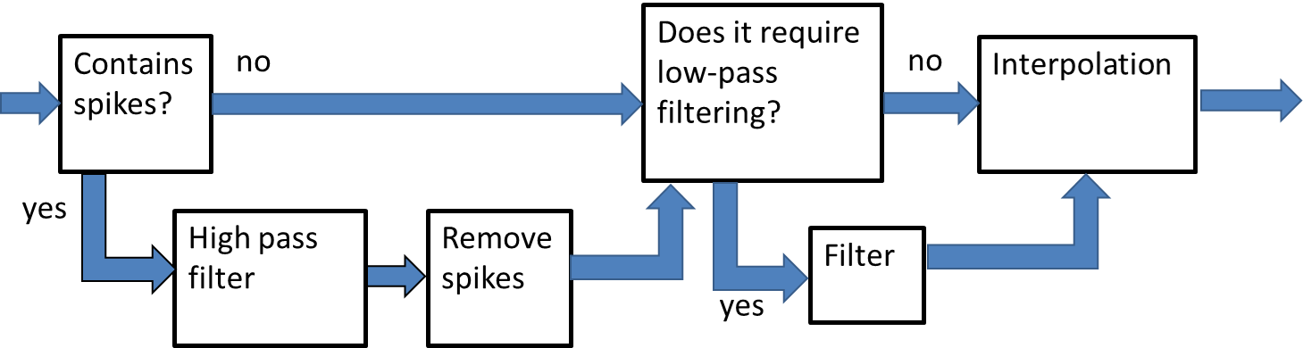
Data pipeline 1 (allows data with spikes to pass through un-processed)
Data pipeline 2 (now processes data with spikes)
Data pipeline 3 (now allows data affected by reversals to pass through un-processed)

Slide 6
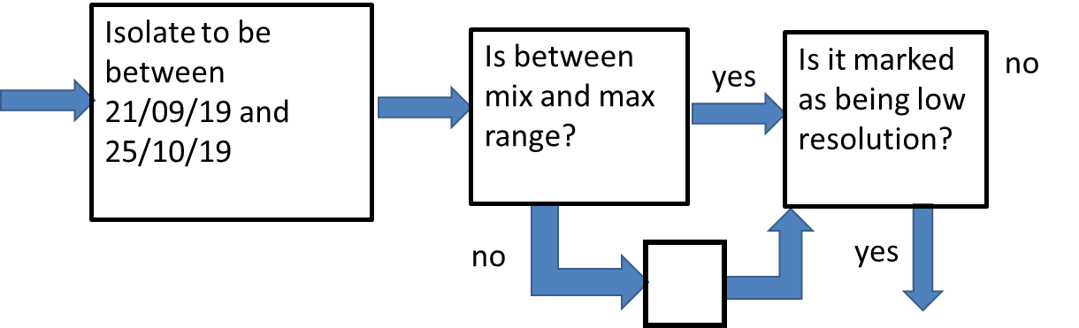
Data pipeline 4 (now allows data outside min-max to pass through un-processed)
Simply allowing all data though, even if it outside of the min-max range, is clearly not desirable but it will do for now, for the purpose of this experiment. In the future we can put something in this box…

Slide 7
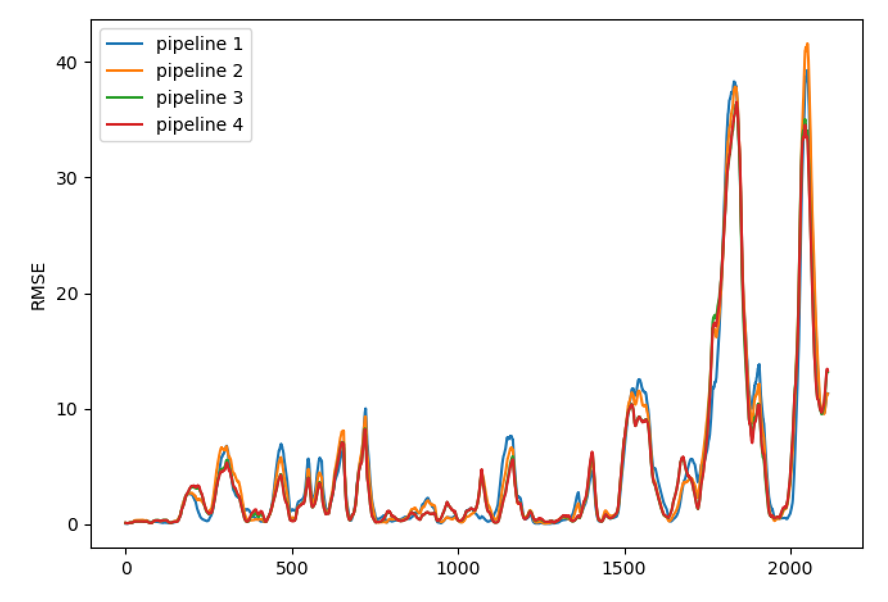
Pipeline | Av. RMSE
1 | 4.59
2 | 4.70
3 | 4.31
4 | 4.30

Slide 8
To-do (short-term)
Currently no time lags associated with campaign data.
Need bespoke filtering for some of the signals (we can do this with an extra column in the spreadsheet).
Some of the data outside of ‘eng min-max’ need to be processed and included in the data pipeline.
To-do (longer-term)
Establish and implement strategy for processing data that is affected by reversals.
Repeat analysis that use randomly selected inputs and/or randomly selected time lags.
Consider using a multi-output linear regression

Slide 9
To-do (short-term)
Currently no time lags associated with campaign data.
Need bespoke filtering for some of the signals (we can do this with an extra column in the spreadsheet).
Some of the data outside of ‘eng min-max’ need to be processed and included in the data pipeline.
To-do (longer-term)
Establish and implement strategy for processing data that is affected by reversals.
Repeat analysis that use randomly selected inputs and/or randomly selected time lags.
Consider using a multi-output linear regression

Slide 10
We always check for inputs that have not been assigned time lags.
We were losing campaign data here, specifically
10091 Furnace Load
5134 EEDS Average gross width measurement
as they were not assigned to any time lags.
Diego’s correlation analysis now applied to these data sets:
Tag name | Time lag (hours)
10091 Furnace Load | 51.33
5134 EEDS Average gross width measurement | 0.67

Slide 11
We always check for inputs that have not been assigned time lags.
We were losing campaign data here, specifically
10091 Furnace Load
5134 EEDS Average gross width measurement
as they were not assigned to any time lags.
Diego’s correlation analysis now applied to these data sets:
Note that the current model structure will remove this (more on addressing this later)
Tag name | Time lag (hours)
10091 Furnace Load | 51.33
5134 EEDS Average gross width measurement | 0.67

Slide 12

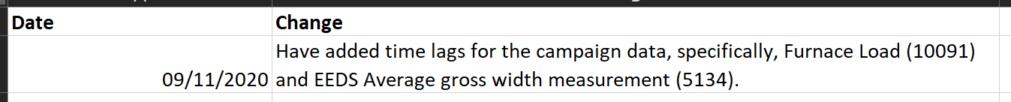
Have created new ‘master spreadsheet’ (with changelog):

Slide 13
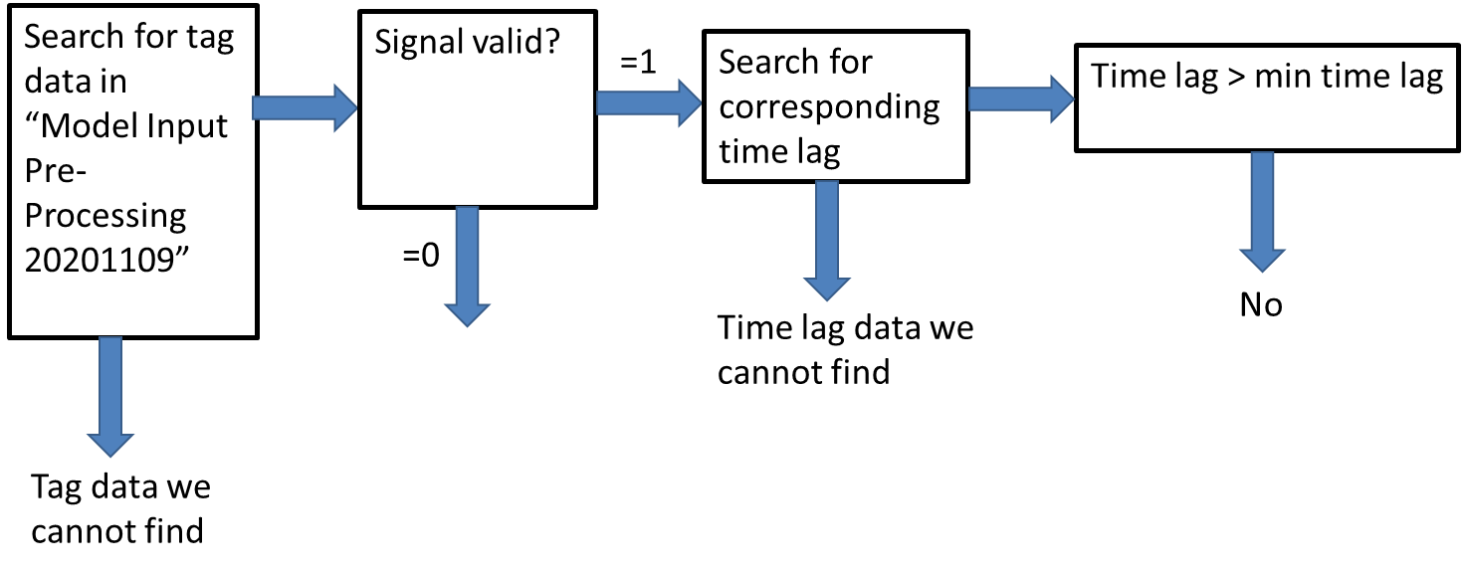
Data pipeline 5 reads from this new spreadsheet (i.e., now includes campaign data with estimated time lags)

Slide 14
Data pipeline 5 reads from this new spreadsheet (i.e., now includes campaign data with estimated time lags)
We no longer lose anything here (but we will keep this code in to catch potential issues in the future)

Slide 15
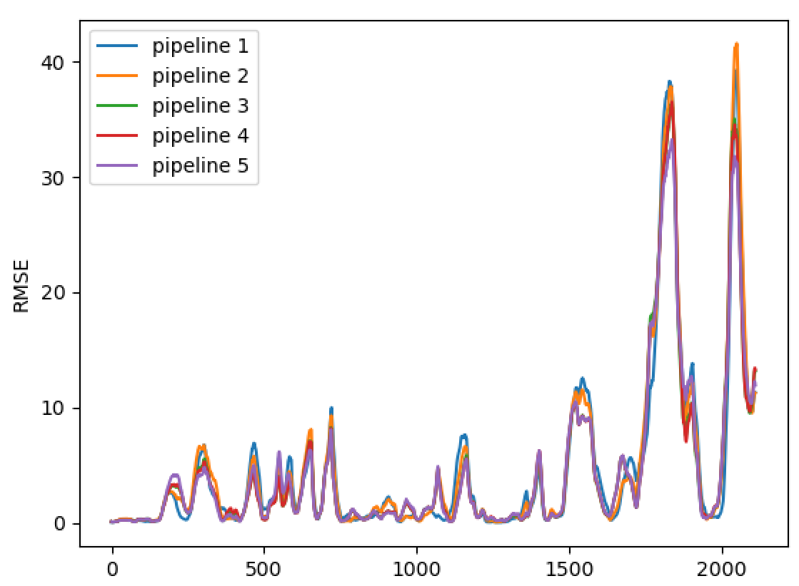
Pipeline | Av. RMSE
1 | 4.59
2 | 4.70
3 | 4.31
4 | 4.30
5 | 4.31
No significant change in performance…

Slide 16
To-do (short-term)
Currently no time lags associated with campaign data.
Need bespoke filtering for some of the signals (we can do this with an extra column in the spreadsheet).
Some of the data outside of ‘eng min-max’ need to be processed and included in the data pipeline.
To-do (longer-term)
Establish and implement strategy for processing data that is affected by reversals.
Repeat analysis that use randomly selected inputs and/or randomly selected time lags.
Consider using a multi-output linear regression

Slide 17
Strategies for processing data that is affected by reversals
Data pipeline 2 (now processes data with spikes)

Slide 18
Strategies for processing data that is affected by reversals
Assuming that the sampling frequency is always 1 minute
Start data processing at the minimum value of the first 20 minutes:
Get the maximum value each 20 signal readings.
Get the max value only when 20 minutes have passed
Start data processing at the minimum value of the first 20 minutes:
Get the maximum value within a 20-minute time period.

Slide 19
Strategies for processing data that is affected by reversals
1) Assuming that the sampling frequency is always 1 minute
Start data processing at the minimum value of the first 20 minutes:
We search for the minimum value of the signal at the first 20 minutes to identify the point before the next firing.
Get the maximum value each 20 signal readings.

Slide 20
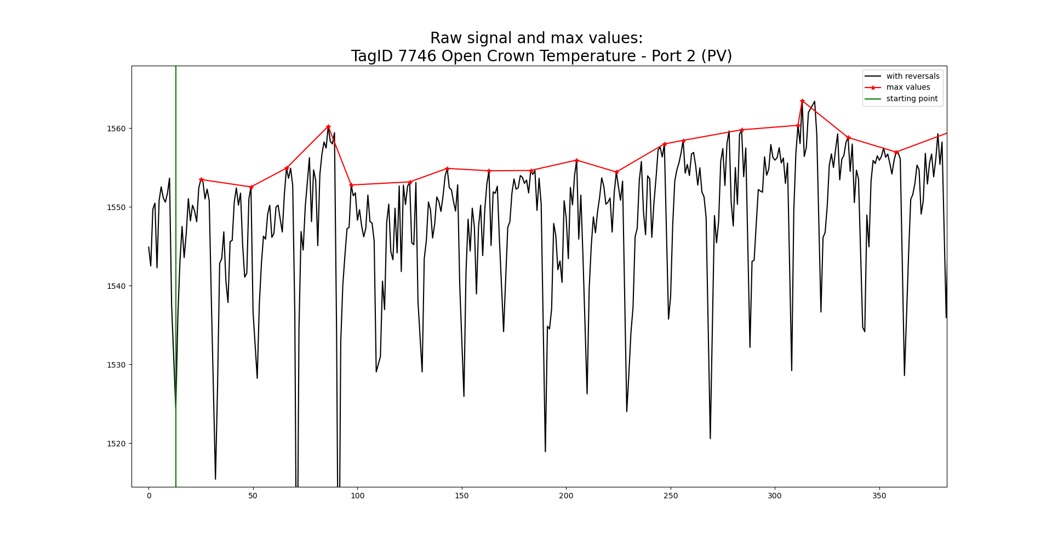
Strategies for processing data that is affected by reversals

Slide 21
Strategies for processing data that is affected by reversals
Starting point

Slide 22
Strategies for processing data that is affected by reversals
1) Assuming that the sampling frequency is always 1 minute
Start data processing at the minimum value of the first 20 minutes:
We search for the minimum value of the signal at the first 20 minutes to identify the point before the next firing.
Get the maximum value each 20 signal readings.

Slide 23
Strategies for processing data that is affected by reversals
Starting point
* Peak values

Slide 24
Strategies for processing data that is affected by reversals
2) Get the max value only when 20 minutes have passed
Start data processing at the minimum value of the first 20 minutes:
We search for the minimum value of the signal at the first 20 minutes to identify the point before the next firing.
Get the maximum value within a 20-minute time period.

Slide 25
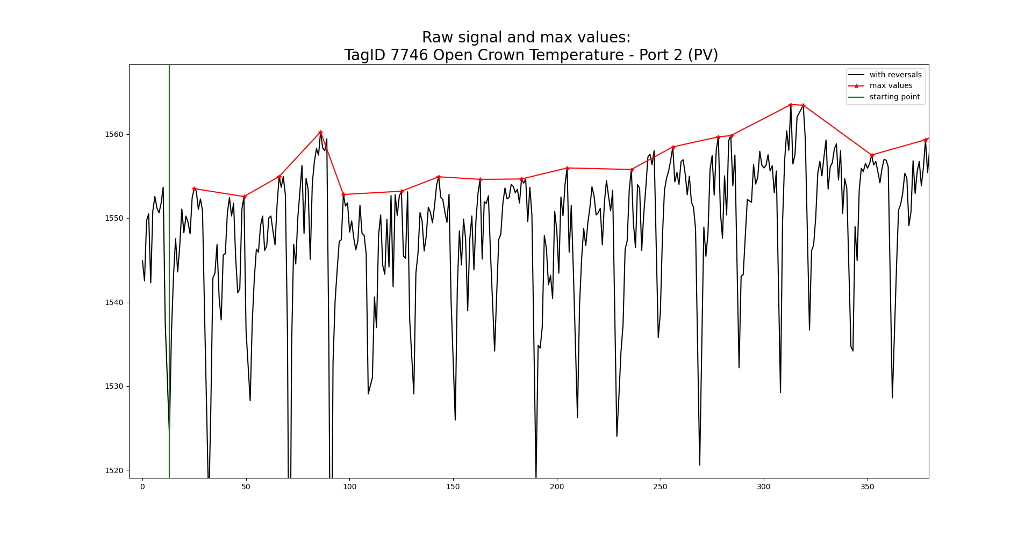
Comparison of reversals strategies
Assuming that the sampling frequency is always 1 minute
Get the max value only when 20 minutes have passed

Slide 26
Some examples using strategy 2

Slide 27
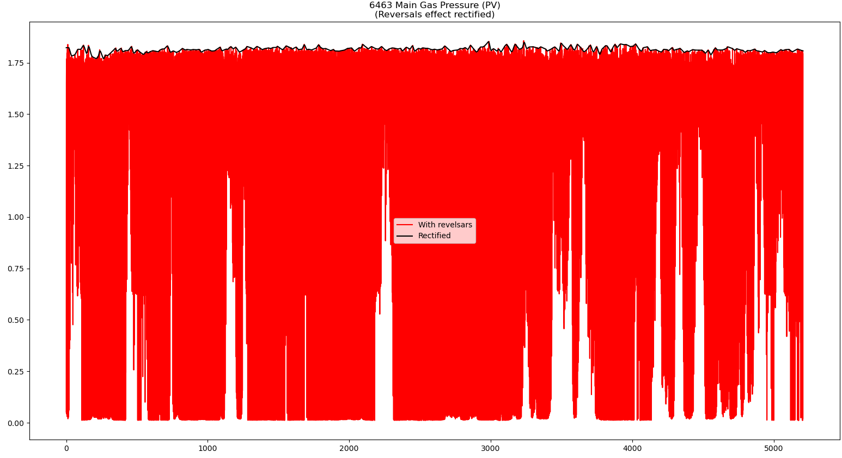

Slide 28
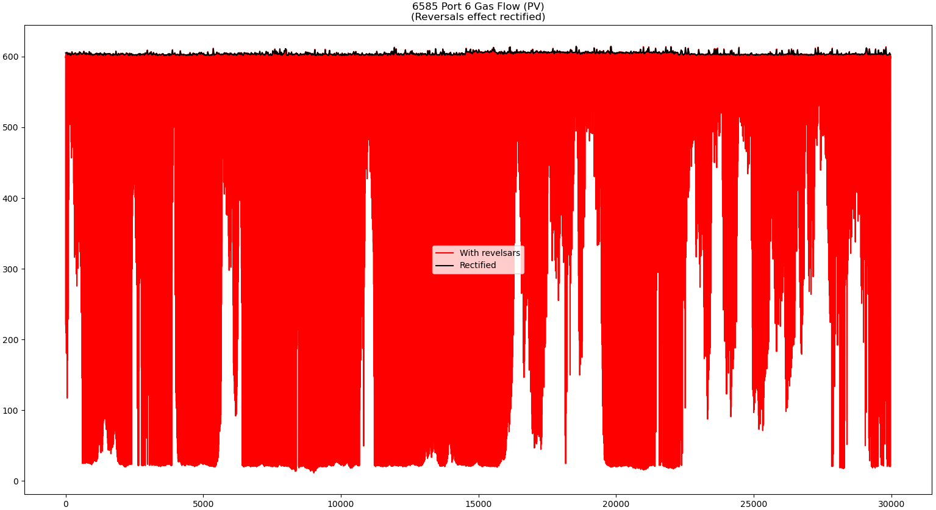

Slide 29
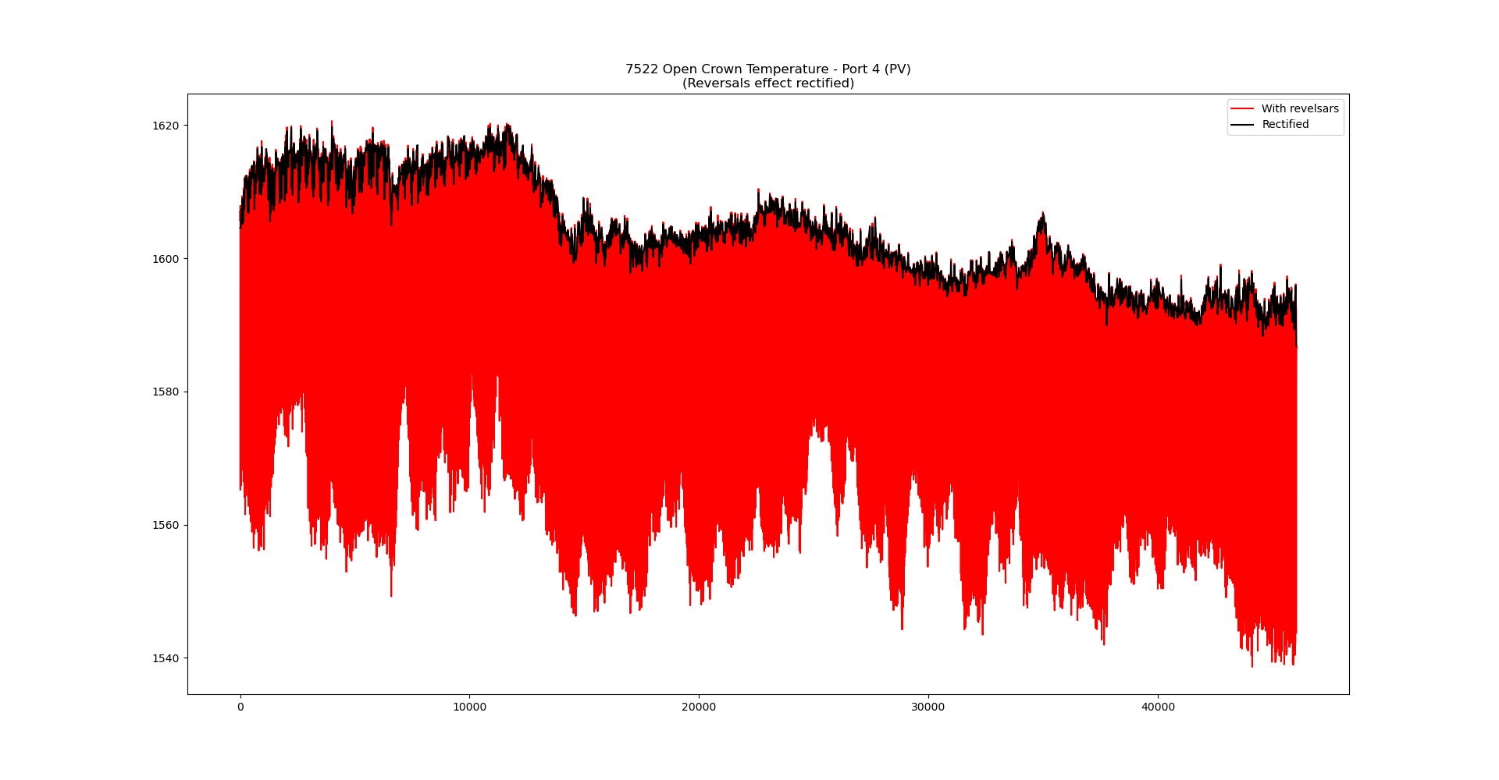

Slide 30
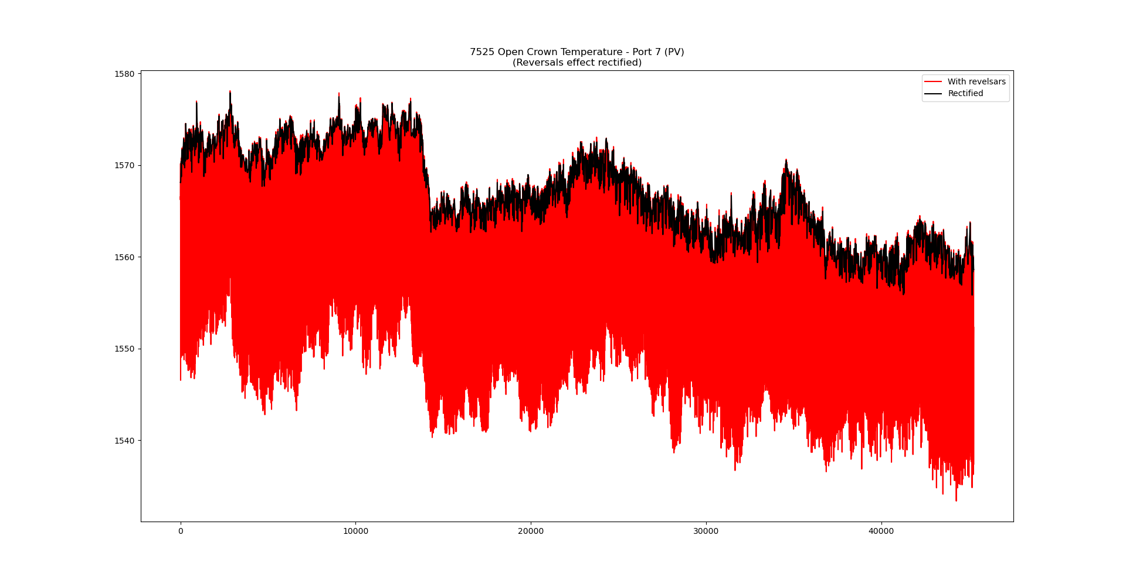

Slide 31
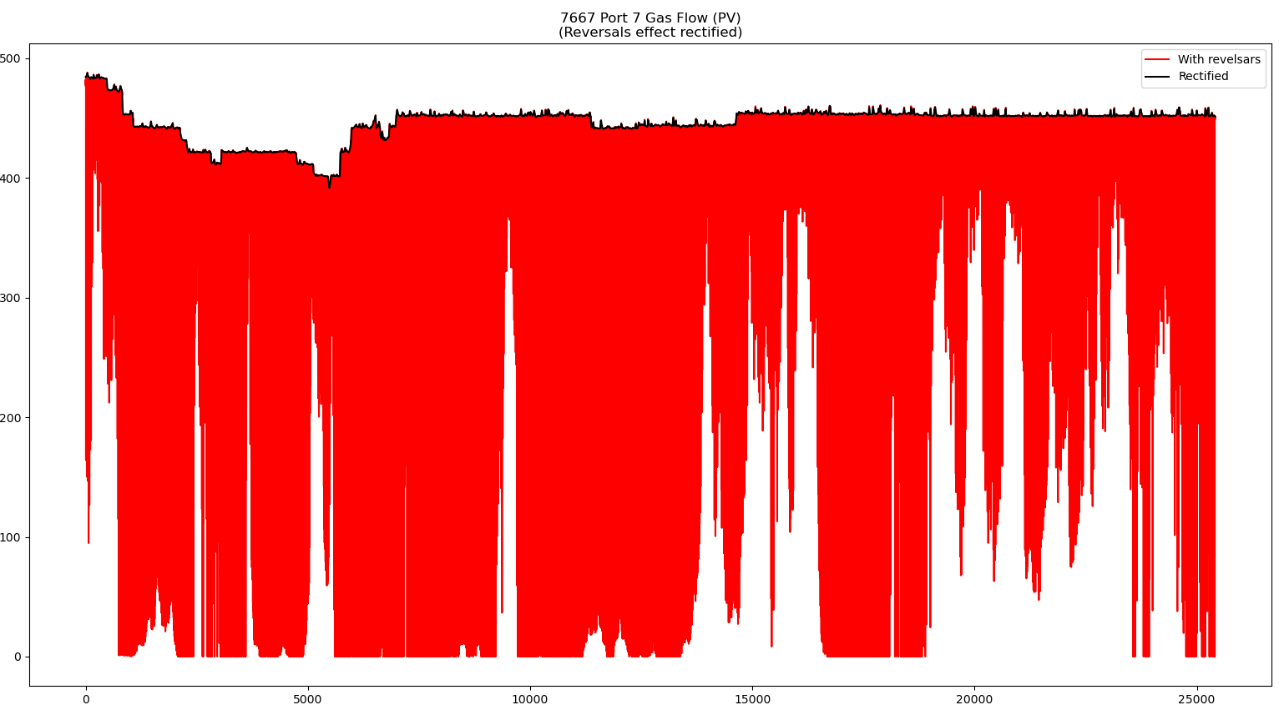

Slide 32
Strategies for processing data that is affected by reversals
Questions for future actions
From the Machine Learning perspective, we could apply a low-pass filter to get a general trend of the signals. However,
1) Is strategy 2 enough? Have Pilkington applied any other strategies to deal with the signals affected by the reversals before?
2) Do we need to capture the “small steps” to identify non-normal functioning in the processes associated with the signals under study?

Slide 33
To-do (short-term)
Currently no time lags associated with campaign data.
Need bespoke filtering for some of the signals (we can do this with an extra column in the spreadsheet).
Some of the data outside of ‘eng min-max’ need to be processed and included in the data pipeline.
To-do (longer-term)
Establish and implement strategy for processing data that is affected by reversals.
Repeat analysis that use randomly selected inputs and/or randomly selected time lags.
Consider using a multi-output linear regression.

Slide 34
Current Model Structure
Max lag
Fault
Density
Time
Min lag
Tag 1
Time
Tag 2
Time

Slide 35
Current Model Structure
Max lag
Fault
Density
Time
Min lag
Tag 1
Time
Tag 2
Time

Slide 36
Current Model Structure
Max lag
Fault
Density
Time
Min lag
Tag 1
Time
Tag 2
Time

Slide 37
Current Model Structure
Max lag
Fault
Density
Time
Min lag
Tag 1
Time
Tag 2
Time

Slide 38
Multi-output linear regression
Lag 2
Fault
Density
Time
Lag 1
Tag 1
Time
Tag 2
Time

Slide 39
Multi-output linear regression
Lag 2
Fault
Density
Time
Lag 1
Tag 1
Time
Tag 2
Time

Slide 40
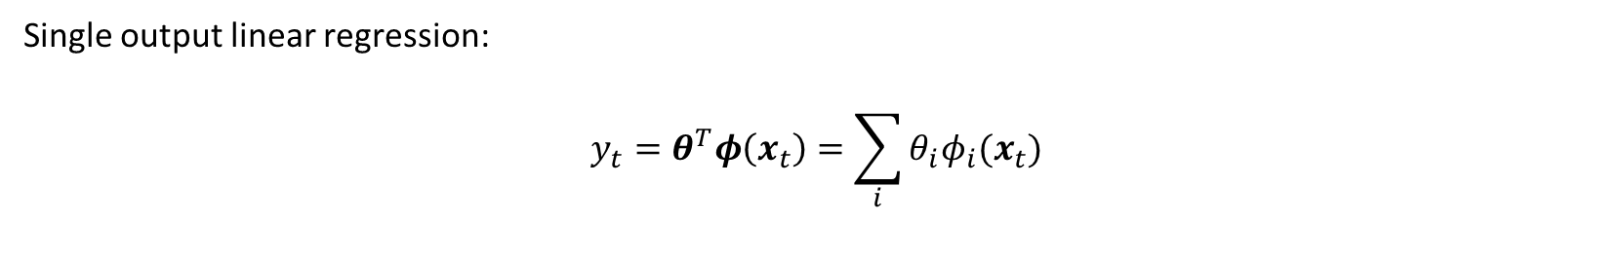
Single output linear regression: $$y_{t}=θ^{T}φ\left(x_{t}\right)=\sum_{i}{θ_{i}φ_{i}(x_{t})}$$

Slide 41
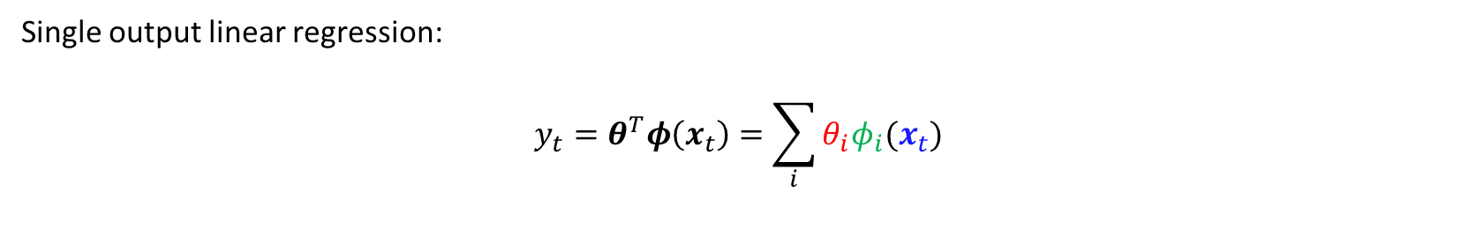
Parameters used to estimate ‘importance’ of each input
Tag data
Single output linear regression: $$y_{t}=θ^{T}φ\left(x_{t}\right)=\sum_{i}{θ_{i}φ_{i}(x_{t})}$$
Basis function (for now we have $φ\left(x\right)=x$)

Slide 42

Parameters used to estimate ‘importance’ of each input
Tag data
Single output linear regression: $$y_{t}=θ^{T}φ\left(x_{t}\right)=\sum_{i}{θ_{i}φ_{i}(x_{t})}$$
Multi-output linear regression:
$$\left(\begin{matrix}y_{t} \\ y_{t+1} \\ y_{t+2}\end{matrix}\right)=\left[\begin{matrix}θ_{1}^{T} \\ θ_{2}^{T} \\ θ_{3}^{T}\end{matrix}\right]φ\left(x_{t}\right)$$
Basis function (for now we have $φ\left(x\right)=x$)

Slide 43
Parameters used to estimate ‘importance’ of each input
Tag data
Single output linear regression: $$y_{t}=θ^{T}φ\left(x_{t}\right)=\sum_{i}{θ_{i}φ_{i}(x_{t})}$$
Multi-output linear regression:
$$\left(\begin{matrix}y_{t} \\ y_{t+1} \\ y_{t+2}\end{matrix}\right)=\left[\begin{matrix}θ_{1}^{T} \\ θ_{2}^{T} \\ θ_{3}^{T}\end{matrix}\right]φ\left(x_{t}\right)$$
Basis function (for now we have $φ\left(x\right)=x$)
Note: no longer have to remove tag data with shorter time lags than the time we are interested in. We can also induce correlations between subsequent readings of fault density. For example…

Slide 44
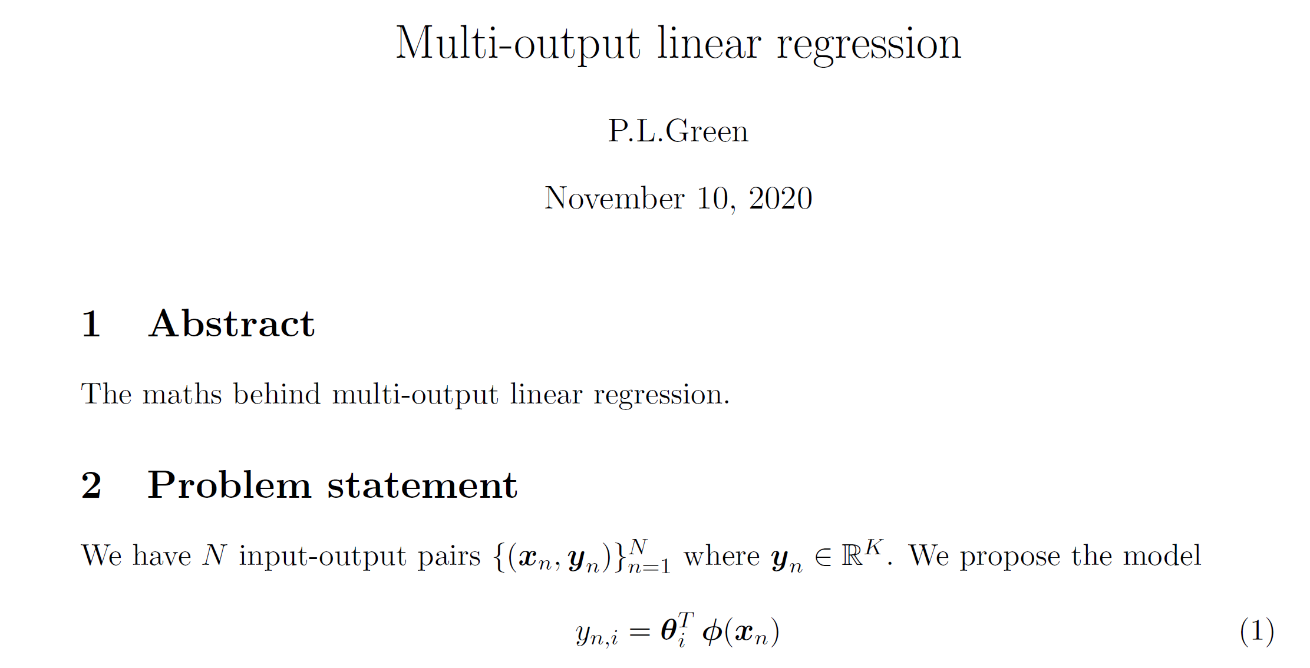

(Induced correlation)
$$\left(\begin{matrix}y_{t} \\ y_{t+1} \\ y_{t+2}\end{matrix}\right)=\left[\begin{matrix}θ_{1}^{T} \\ θ_{2}^{T} \\ θ_{3}^{T}\end{matrix}\right]\left(\begin{matrix}x_{t,1} \\ x_{t,2}\end{matrix}\right)=\left[\begin{matrix}1 & 0 \\ 1 & 0 \\ 0 & 1\end{matrix}\right]\left(\begin{matrix}x_{t,1} \\ x_{t,2}\end{matrix}\right)$$
Maths behind this in the following report:

Slide 45
To-do (short-term)
Currently no time lags associated with campaign data.
Need bespoke filtering for some of the signals (we can do this with an extra column in the spreadsheet).
Some of the data outside of ‘eng min-max’ need to be processed and included in the data pipeline.
To-do (longer-term)
Establish and implement strategy for processing data that is affected by reversals.
Repeat analysis that use randomly selected inputs and/or randomly selected time lags.
Consider using a multi-output linear regression.

Slide 46
To-do (short-term)
Currently no time lags associated with campaign data.
Need bespoke filtering for some of the signals (we can do this with an extra column in the spreadsheet).
Some of the data outside of ‘eng min-max’ need to be processed and included in the data pipeline.
To-do (longer-term)
Establish and implement strategy for processing data that is affected by reversals [ongoing].
Repeat analysis that use randomly selected inputs and/or randomly selected time lags.
Consider using a multi-output linear regression [ongoing].

